Slide 1

The Bold Claim That AGI And AI Superintelligence Will Radically Fragment Society
Week of February 9
Jacob Appling

Slide 2
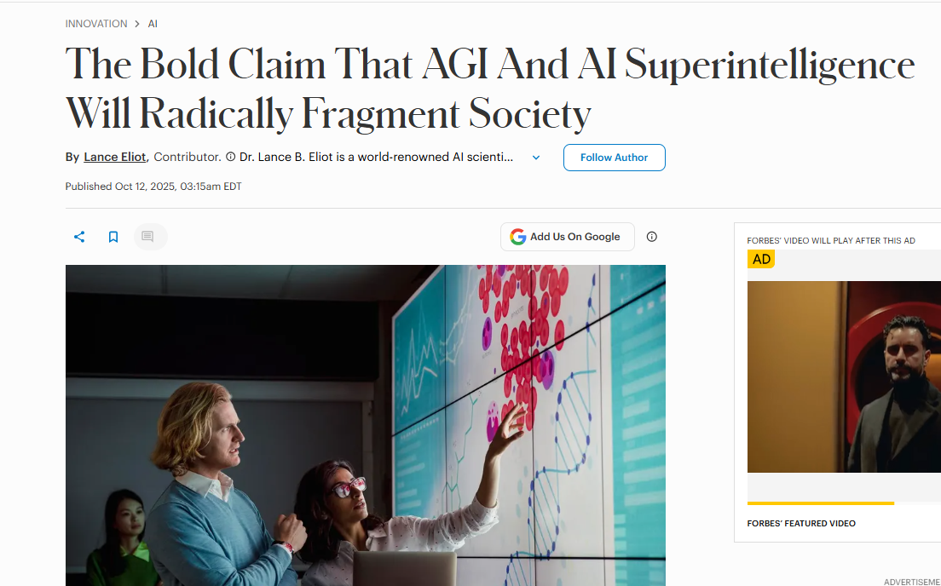
Article #4 (Row 4 via Google Sheet)

Slide 3
Link to the Source
https://www.forbes.com/sites/lanceeliot/2025/10/12/the-bold-claim-that-agi-and-ai-superintelligence-will-radically-fragment-society/

Slide 4
Main Findings
Central Thesis: The article explores a provocative idea that the advent of Artificial General Intelligence (AGI) and potentially Artificial Superintelligence (ASI) could fragment human society into competing and divided factions rather than unify humanity.
Why Fragmentation Might Occur: The claim rests on the notion that different groups of people will interpret and respond to AGI guidance in radically different ways. Instead of a cohesive societal consensus, people may form ideological camps — much like political or religious factions — based on who they trust, how they use AGI, and what AGI “advice” they follow.
Zealotry Around AGI: One key argument is that some individuals might view AGI as a kind of oracle, supreme prophet, or absolute authority. This perception could drive belief systems and behaviors that further divide groups of people.
Polarized Dependence: As AGI becomes deeply embedded in social, economic, and personal decision-making, differing interpretations of AGI outputs could amplify existing divisions and create new ones, intensifying polarization.

Slide 5
Broader implications for society
New Social Fault Lines: Rather than a unified human response to AGI, the article suggests societies might split along lines of trust, allegiance, or ideology tied to different AI paradigms and recommendations.
Risk of Ideological Extremes: People treating AGI as an unquestionable authority may reject expert consensus, democratic processes, or scientific evidence in favor of following AI-derived “truths,” potentially fueling extremism or misinformation loops.
Erosion of Shared Reality: If subsets of the population begin acting on different AI outputs or interpretations, shared societal narratives — which are necessary for collective decision-making — may collapse, making coordinated responses to crises (pandemics, climate change, war, etc.) harder or impossible.
Psychological and Cultural Shifts: Trust in human institutions (governments, education systems, media) might erode if AGI is seen as superior or infallible by significant segments of the population.

Slide 6
Relevance and potential influence on the construction industry
Though not specific to construction, the themes in the article can be connected to that sector in several consequential ways
Workforce and Organizational Fragmentation: Division in Adoption: Within construction firms, different teams or companies might adopt different AGI tools or rely on different AGI-derived methodologies, leading to non-standard practices, compatibility issues, and fractured workflows across the industry.
Decision-Making and Guidance: Conflicting Guidance: If AGI systems provide differing design or management recommendations — especially in complex areas like safety planning, risk assessment, or scheduling — factions within projects could form around which AI “expert” to trust. This might slow decision cycles or create internal disputes.
Training and Standards: Fragmented Training Regimes: AGI-based training systems could teach different techniques or safety norms based on their underlying models. Without industry-wide alignment, this risks inconsistent skill levels and safety standards among workers.
Technology Governance and Regulation: Divergent Regulation: Fragmented societal attitudes toward AGI could result in inconsistent regional or company-specific regulations affecting how AI is used in construction (e.g., permitting decisions, risk assessments, autonomous equipment operations).
Innovation Pace: Rapid AI Adoption vs Resistance: Some firms might quickly integrate AGI-powered design and project management systems, while others resist, creating competitive imbalances and fractured supply chains.

